Slide 1
Adult Learning Transactions
By:
Deana Sanders, Heidi Gordon,
Casey Todd, Debra Garza
April 6, 2015
AET/500
Mary Joseph-Martin

Slide 2
Introduction
Two Models: Traditional and Non-Traditional models
Instructional models and strategies explain the process of producing an instructional design to improve knowledge in adult learning

Slide 3
Traditional Models
Notes:
These instructional models are commonly based on Analysis, Design, Development, Implementation and Evaluation (ADDIE). These are the most common components of the model even though some traditional models do have additional areas. They can also be thought of as a map or guide in learning, there are three models: ADDIE, Dick and Carey and Bloom’s Learning Taxonomy.

Slide 4
Characteristics of Adult Learners
Typically 17 – 25 years of age
Students are dependent on the teacher for what, how, and when information is to be learned
Students are passive / not reflective
Students bring little experience into the learning process
Communication is one-way
Students rely on the teacher to tell them what to learn in order to advance to the next level
Students are motivated to learn primarily through external pressures

Slide 5
Traditional Learning Styles
Aural Learner | Visual Modality | Kinesthetic Modality
Remembers ideas verbally presented | Learns by seeing and watching demonstrations | Learns by doing, direct involvement
Learns well through lecture | Likes visual stimuli such as pictures, slides, graphs | Often fidgets or finds reasons to move
Excellent Listener | Often stares | Often a poor listener
Can reproduce symbols, letters, or words by hearing them | Conjures up the image of a form by seeing it in the “mind’s eye” | Often finds success in physical responses to activities
Likes to talk | Needs something to watch | Gestures when speaking
Enjoys plays, dialogues, dramas, music | Is often quiet and does not talk at length | Tries things out and likes to manipulate objects
Can learn concepts by listening to tapes | Becomes impatient when listening is required | Inattentive to visual or auditory presentations

Slide 6
Application
Rationale for
Model Selection
Application for Use
Accepted and standard way to keep training organized
Model can be chosen in setting where curriculum is practical and standard
Used as an effective tool for career training or learning in the classroom
Notes:
Instructional Design Models and Methods. (2012). Retrieved from http://www.instructionaldesigncentral.com/htm/IDC_instructionaldesignmodels.htm

Slide 7
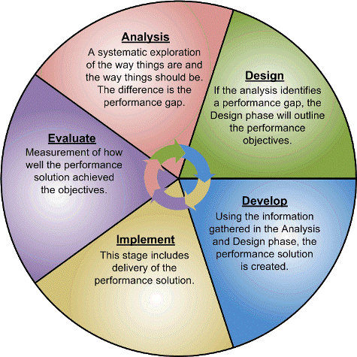
The ADDIE Model
Notes:
Forest, E. (2014). Educational Technology: The ADDIE Model: Instructional Design. Retrieved from http://educationaltechnology.net/the-addie-model-instructional-design/
Image retrieved from: http://www.addiesolutions.com/addie.htm

Slide 8
Dick and Carey Design Model
Revise
Instruction
Conduct
Instructional
Analysis
Identify
Instructional
Goals
Write
Performance
Objective
Develop
Criterion
Reference
Tests
Develop
Instructional
Strategy
Develop &
Select
Instructional
Materials
Develop &
Conduct
Performance
Evaluation
Identify
Entry
Behaviors
Develop &
Conduct
Summative
Evaluation
Notes:
Instructional Design Models and Methods. (2012). Retrieved from http://www.instructionaldesigncentral.com/htm/IDC_instructionaldesignmodels.htm

Slide 9
Bloom’s Learning Taxonomy
Notes:
Anderson and Krathwohl changed the terms in Bloom’s cognitive skill levels form nouns to verbs to indicate that the skills were indicators of active engagement. The perception for many educators in the past has been that learners need to master one level in order to move on to the next level. This is not true. As learners acquire knowledge , they move up and down the skill levels.
Discovery Education Kathy's Katch. (2014, August 5). Retrieved April 5, 2015, from http://blog.discoveryeducation.com/blog/2014/06/01/the-importance-of-now/

Slide 10
Andragogical Principles
The Addie Model | Dick & Carey Model | Bloom’s Learning Taxonomy
Experiences | Experiences | Self concept
Readiness to learn during | Orientation to learn | Experiences
Motivation to learn | Motivation to learn | Readiness to learn
The need to know |  | Orientation to learn
 |  | Motivation to learn
 |  | The need to know
Notes:
Knowles learning principles can be employed to each traditional instructional model. Each principle can relate to stages found in each model in regards to the how the instructor delivers information that is presented to the learner. The ADDIE model uses five stages: analysis, design, development, implementation and evaluation. Educators find this approach very useful having stages clearly defined which makes implementation of instructions effectively (Forest, 2014). It also it provides a means for sound decision making in order to determine the who, what, when, where, why, and how of a learning program (Clark, 1995).
The Dick & Carey model is most popular model in schools and educational environments. The model addresses instruction as an entire system, focusing on the interrelationship between context, content, learning and instruction (instructionaldesigncentral). This model has ten components. According to Dick and Carey, "Components such as the instructor, learners, materials, instructional activities, delivery system, and learning and performance environments interact with each other and work together to bring about the desired student learning outcomes“ (instructionaldesigncenter). Three learning principles comes to mind with the use of this model. Experience, orientation to learn and motivation to learn.
Bloom’s taxonomy is a classification system used to define and distinguish different levels of human cognition- thinking, learning, and understanding. Educators have typically used Bloom’s taxonomy to inform or guide the development of assessments (tests and other evaluations of student learning), curriculum (units, lessons, projects, and other learning activities), and instructional methods such as questioning strategies (http://edglossary.org/blooms-taxonomy/). All learning principles can be employed within this model as each level of this model associates from different aspects of a learning. Learners are able to think individually and creatively. Bloom’s taxonomy can be used as a teaching tool to help balance assessment and evaluative questions in class, assignments and texts to ensure all orders of thinking are exercised in student’s learning (Heer) .

Slide 11
Support Services
Writing Centers
Tutoring Centers
Library
Mentoring Counseling
Academic Counseling
Computer Labs
Supplemental Instruction
Academic Coaching
Student Health / Counseling Center
Notes:
Image retrieved from: https://www.ied.edu.hk/sao/?p=133

Slide 12
Reflection Critical Thinking
Traditional adult learners rely on the teacher to tell them what, how, and when to learn
Little to no room for reflection and application to life experiences
No critical thinking components

Slide 13
Non-Traditional Models

Slide 14
Characteristics of Adult Learners
Ages 17 - Adulthood
Learning is a collaborative process between teachers and students
Students are self-directed
Students apply their experiences to enrich their learning process
Communication is two-way
Students are motivated to learn primarily through internal pressures

Slide 15
Instructional Strategies
Case-Based Learning or Case Method Teaching
Discussion Questions
Debate
Quizzes and Exams
Jig Saw
Peer Instruction
Problem-Based Learning
Notes:
Retrieved from: http://www.montana.edu/facultyexcellence/Papers/activelearn2.html

Slide 16
Application
Rationale for
Model Selection
Application for Use
Used for a more specialized audience or learning environment
Flexible
More specialized to specific learning topics
May be more appealing and give better results for learner
Various reasons why non-traditional model is more effective
Adult Learning
Online Learning
Goal Oriented Training
Notes:
Instructional Design Models and Methods. (2012). Retrieved from http://www.instructionaldesigncentral.com/htm/IDC_instructionaldesignmodels.htm

Slide 17
ARCS
Notes:
Instructional Design Models and Methods. (2012). Retrieved from http://www.instructionaldesigncentral.com/htm/IDC_instructionaldesignmodels.htm

Slide 18
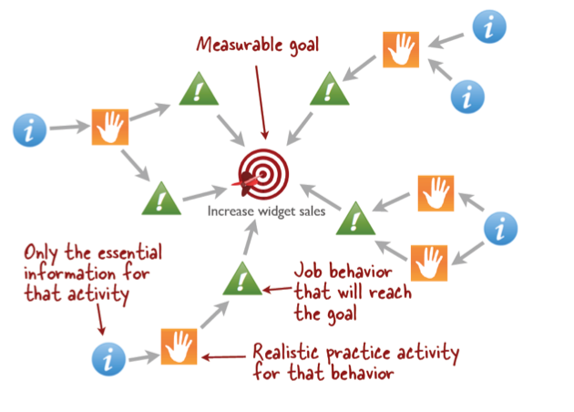
Cathy Moore’s Action Mapping
Notes:
Instructional Design Models and Methods. (2012). Retrieved from http://www.instructionaldesigncentral.com/htm/IDC_instructionaldesignmodels.htm

Slide 19
Andragogical Principles
ARCS Model | Cathy Moore Action Mapping
Self-concept (Attention) | Experiences (Design practice activities)
Experiences (Relevance) | Readiness to learn (Identify what people need to do and what people need to know)
Readiness to learn (Confidence and satisfaction) | The need to know (Identify what people need to do)
Orientations to learn (Relevance)
Motivation to learn (Entire model)
The need to know (Satisfaction)
Notes:
The ARCS motivational design process is a systematic problem solving approach that requires knowledge of human motivation and progresses from learner analysis to solution design (Keesee, 2009). All learning principles can be employed by the ARCS as seen in the chart.
Action Mapping is a quick, effective, and visual way to design compelling learning experiences for instructional products including eLearning, simulations, and in person training events (instructionaldesigncental.com). Cathy Moore Action Mapping model encourages self direction as learners are only provided information vital to the tasks and able to process it in their own way. Instructors are encouraged to only provide information that is meaningful to learning, nothing more. .” Rather than including loads of information and tossing in a quick quiz, Moore claims that Action Mapping results in real actions, rather than merely delivering information. Moore also claims, “A tool like the action map makes everyone focus on the business reason for the project and keeps extraneous information out – it provides discipline (Wroten, 2012)”.

Slide 20
Support Services
Professors / Educators
Academic Advisors
Peer Collaboration
Discussion Groups
Professional Experiences
Notes:
Image retrieved from: https://www.google.com/search?q=picture+of+people+helping+each+other&rlz=1C1VASI_enUS512US512&espv=2&biw=1366&bih=599&tbm=isch&tbo=u&source=univ&sa=X&ei=TTggVbr8IMzzsAW964DQBw&ved=0CDIQ7Ak

Slide 21
Reflection Critical Thinking
Leads students through inquiry and evaluation
Develops logical, analytical, and decision making skills
Encourages problem solving and critical thinking
Notes:
Harris, P. & Johnson, R. Non-Traditional Teaching and Learning Strategies. Retrieved from http://www.montana.edu/facultyexcellence/Papers/activelearn2.html
Image retrieved from:
https://www.google.com/webhp?sourceid=chrome-instant&rlz=1C1VASI_enUS512US512&ion=1&espv=2&ie=UTF-8#q=picture%20of%20light%20bulb

Slide 22
Conclusion
Traditional Model | Non-Traditional Model
Students are passive learners, relying solely on the teacher for instruction | Students are self-directed, active learners, collaborating with each other
Communication is one-way | Communication is two-way
Students learn through external pressures | Students learn through internal pressures
Students bring very little experience to the learning process | Students utilize their wealth of experience to assist in the learning process
Models of instruction: The ADDIE Model, Dick and Carey Design Model, Bloom’s Learning Taxonomy | Models of instruction: ARCS, Cathy Moore’s Action Mapping

Slide 23
References
Bloom’s taxonomy. (2014). The Glossary of Education Reform. Retrieved from http://edglossary.org/blooms-taxonomy/
Clark, D. (1995). Why instructional system design and ADDIE? Big Dog and Little Dog’s Performance Juxtaposition. Retrieved from http://www.nwlink.com/~donclark/hrd/sat1.html
Forest, E. (2014). The ADDIE model: Instructional design. Retrieved from http://educationaltechnology.net/the-addie-model-instructional-design/
Harris, P. & Johnson, R. (n.d.). Non-traditional teaching and learning strategies. Retrieved from http://www.montana.edu/facultyexcellence/Papers/activelearn2.html
Instructional design models and methods. (2012). Retrieved from http://www.instructionaldesigncentral.com/htm/IDC_instructionaldesignmodels.htm
Keesee, G. (2009). ARCS model of motivational design. Retrieved from http://teachinglearningresources.pbworks.com/w/page/19919538/ARCS%20Model%20of%20Motivational%20Design
Knowles, M., Holton, E., & Swanson, R. (2012). A theory of adult learning: Andragogy. Adult Learner: The Definitive Classic in Adult Education and Human Resource Development. pp. 60-67. New York, NY: Routledge.
Learning styles retrieved. (2015). Retrieved from http://dameditors.ca/wp-content/uploads/2013/01/Learning-Style-chart-2.jpg
Overview of the seven perceptual styles. (n.d.). Retrieved from http://www.learningstyles.org/styles/index.html
Student resources and services. (n.d.). Retrieved from http://www.utsa.edu/dtcamp/studentres.html
Wroten, C. (2012). 4 simple steps to e-Learning design: Action mapping by Cathy Moore. Retrieved from http://lectora.com/blog/4-simple-steps-e-learning-design-action-mapping-cathy-moore/

